Slide 1

RNA damage induced DHX9 granules
Yilong Zhou
Akhtar Lab

Slide 2
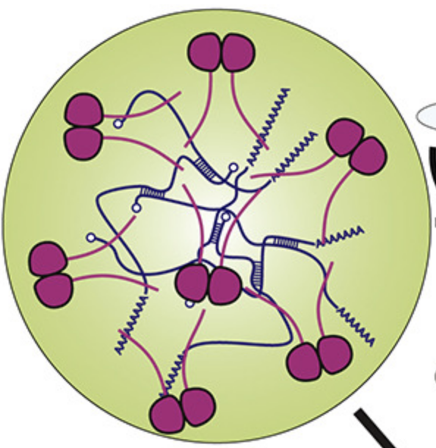
Stress
heat shock, arsenite, infection
starvation, UVC…
DNA
mRNA
Membraneless liquid granules
AAAAA
RNA
RBP…
ATPase
Helicase
Ub ligase
etc…
Translation
LLPS
AAAAA
AA
P body
autophagy
antiviral
survival

Slide 3

DHX9: a nuclear RNA helicase binding dsRNA
Drosophila
Mammalian
MLE
exon 1
exon 3
IR-Alu
DHX9
roX1/2 RNA
MOF
exon 2
MSL1,2,3
Circular RNA
self dsRNA
X chr Dosage Compensation
exon 2
+
Hallacli et al. Mol cell. 2012
Ilik et al. Mol cell. 2013
Valsecchi et al.Nature.2020
Aktas et al.Nature.2017
exon 1
exon 3
Notes:
dhx9 is a nuclear rna helicase binding dsrna. in drosophila, it is named mle and binds with rox rna and contribute to x chr dosage compensation with msl complex. in mammalian cells, dhx9 binds with ir-alu dsrna in mRNA and suppressed the improper generation of circular rna and self dsRNA

Slide 4
UVC induces cytoplasmic DHX9 granules
DHX9
G3BP1
DAPI
Merge
UVC
G3BP1: a SG marker
Arsenite
Heat shock
Hela
Notes:
we first co stained dhx9 with g3bp1, a marker of SG, and find that this granule are stress granules. but to our surprise, we can not detect dhx9 in canonical stress granules induced by arsenite and heat shock, though we see stress granules in these cells.

Slide 5
dsRNA did not induce cytoplasmic DHX9 granules
dsRNA
DHX9
G3BP1
DAPI
Merge
poly(I:C)
IR-Alu
poly(I:C)
+
UVC
Notes:
as DHX9 binds with dsRNA, we think maybe it is dsRNA related. we transfected viral dsrna mimics polyIC or IR-alu dsrna to cells, indeed, we see stress granules in the cells, but to our surprise, dhx9 is not in these sg neither. moreover, when we give cells dsrna and uvc stress together, we see both dhx9 positive and negative sgs independently, which indicated that dsrna-induced sg did not recruit dhx9

Slide 6
UVC and UVB induce DHX9 granules
UVC(254nm) and UVB(312nm): high energy, directly damage DNA
UVA(365nm): low energy, weakly damage DNA indirectly by ROS in high dose
DHX9, DAPI
UVC
UVB
UVA
Hela
Notes:
then we go back to uv stress, as you know, there are three different kinds of UV light, UVC and UVB are short wavelength with high energy, and they can damage our dna directly. another uv is uva, which has low energy and only damage something in a very high dose. we found that both UVC and UVB can induce dhx9 granule but not UVA

Slide 7
Stress
UVC and UVB induce DHX9 granules
Cytosolic DHX9 granules
1. UVC, UVB
+
2. UVA
-
-
3. Oxidative stress (Arsenite)
4. Heat shock stress (42°C)
-
5. Hypersomic stress (NaCl )
-
-
DNA damage?
6. dsRNA, starvation….
7. Etoposide/Doxorubicin/Gamma ray/
Hydroxyurea/DMBA/Camptothecin/
H2O2/ MMS/4NQO…
RNA damage?
-
8. Etoposide + poly(I:C)/arsenite
-
Notes:
a brief summary, we find that uvc and uvb induces dhx9 positive sg, but uva or other canonical stress did not induce dhx9 positive sgs. as uvc and uvb damage dna but not uva, we think that maybe it is a DNA damage response. but to our surprise, we find the DNA damage did not induce dhx9 granules, we tried a lot of different kind of dna damage, none of them generate dhx9 granules, we even tried dna damage plus sg inducer, still ,we did not see any dhx9 granules in the cells. there must be something special happened in UVC and UVB treatment. In fact, apart from DNA, RNA is also damaged by UVC and UVB,. but as you known, many people believe that RNA has short lifetime and it is not important to care about them, compared to DNA damage.

Slide 8
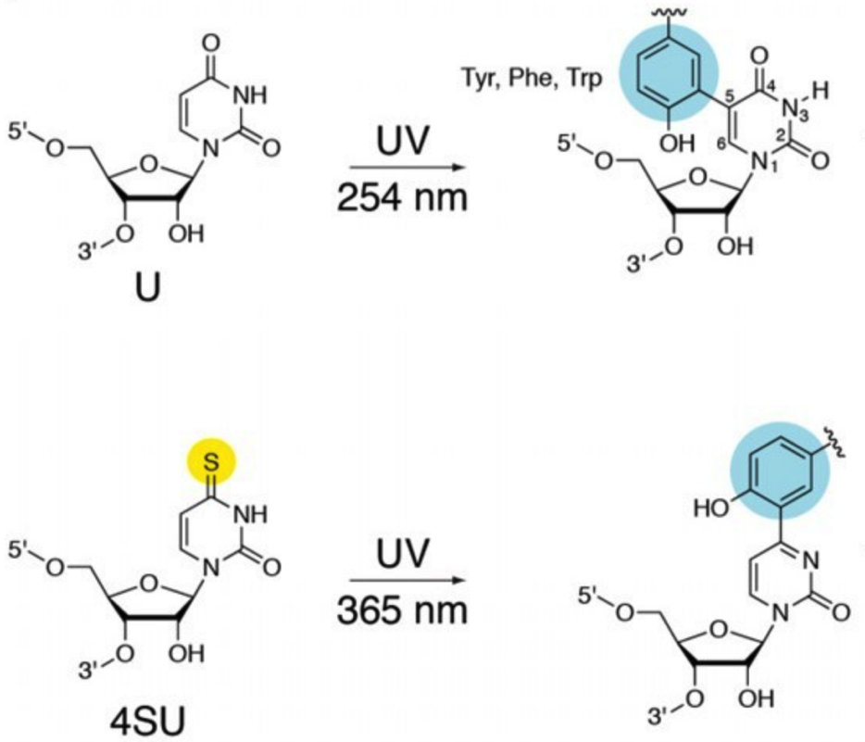
4sU+UVA to mimic UVC- induced RNA damage but not DNA damage
4-thiouridine (4SU): analog of Uridine, activated specifically by UVA and crosslink proximal proteins
Notes:
uvc damage RNA by inducing RNA crosslinked to biomoleculars nearby. for example, uridine can be crosslinked to benzene ring from amino acids. this chemical reaction is widely used in RNA field yet not one tried to explore whether it has some biological consequence. To addess whether RNA damage induces dhx9 granules, we use 4sU to treat the cells, 4sU is an analog of uridine and it is safe and can be incorporated into RNA. It can be specifically activated by UVA and crosslink with proximal biomolecules.

Slide 9
RNA cross-linking induces DHX9 granules
DHX9, DAPI
UVC
UVB
UVA
4-s-U
4-s-U + UVA(0.05J/cm²)
Daily UVA dose in Berlin in April: 70J/cm² ---------------Christiaens et al.2007
Notes:
as you have seen before, uvc and uvb but not uva induces dhx9 granules, to our surprise, 4su plus uva also induces dhx9 granule in the cells but 4sU alone can not. by this experiments we finally figured out that it is RNA crosslink, such a kind of RNA damge, that induces DHX9 granules. One thing I should point out is that last time in my first Tuesday seminar, Gerhard suggests me that dhx9 granules may be caused by RNA damage. Thank you a lot ! An additional knowledge I would like to share with you is that the daily uva dose in berlin in april is 70j/cm2 while the dose we use in our experiment is 0.05j/cm2.

Slide 10
RNA is essential for the DHX9 granule
mock
BSA
Rnase A
Dnase
DHX9-endo-GFP-Hela
Notes:
in a further experiments, we find that while Rnase A eliminate the DHX9 granules, BSA or Dnase treatment did not dissolve the granules, although Dnase reduces DAPI staining.

Slide 11
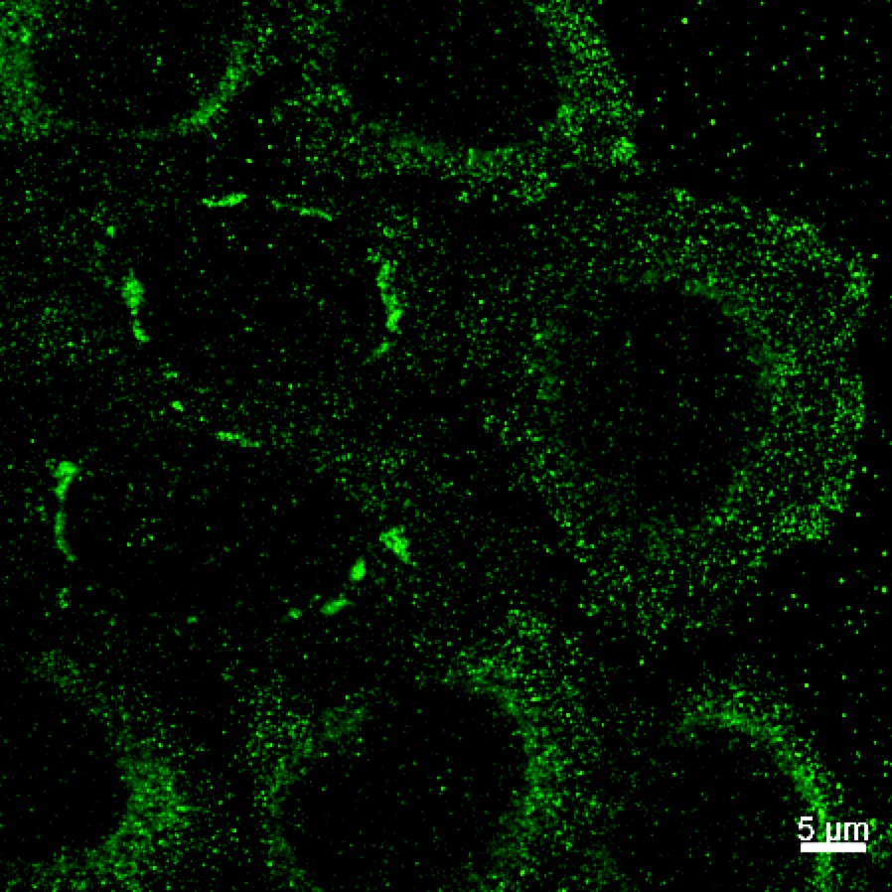
DHX9 granules contains dsRNA
DHX9
J2: dsRNA antibody
DAPI
Notes:
as DHX9 binds with dsRNA, we guess that there are dsRNA in the granules. we stained the cells with J2 antibody which recognize dsRNA. interestingly, there are a lot of dsRNA in the granules.

Slide 12
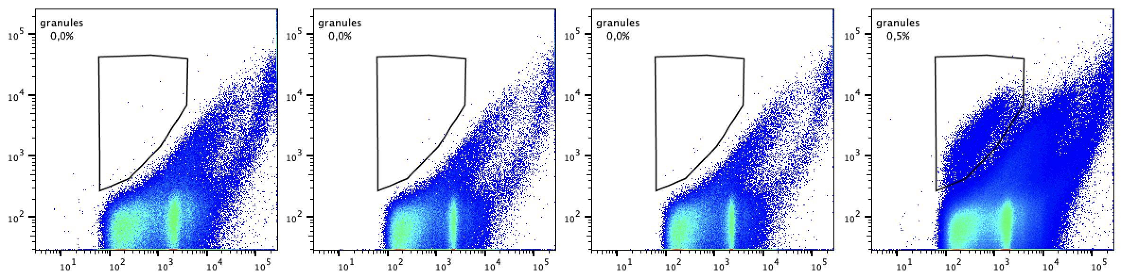
FANCI: Fluorescence Activated Non-membrane Condensates Isolation
a novel methods to isolate stress granules
mock
UVA
4sU
4sU+UVA
G3BP1-mCherry
FANCI of UV stressed cell
SSC
Notes:
I call it FANCI as it comes from the idea of FACS. And fancy facni!

Slide 13
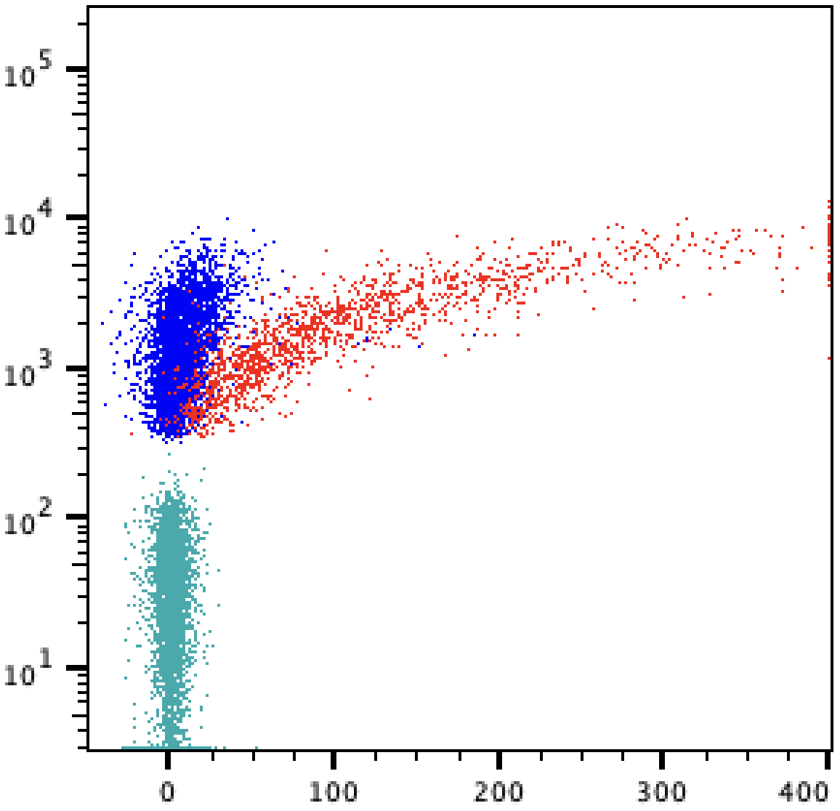
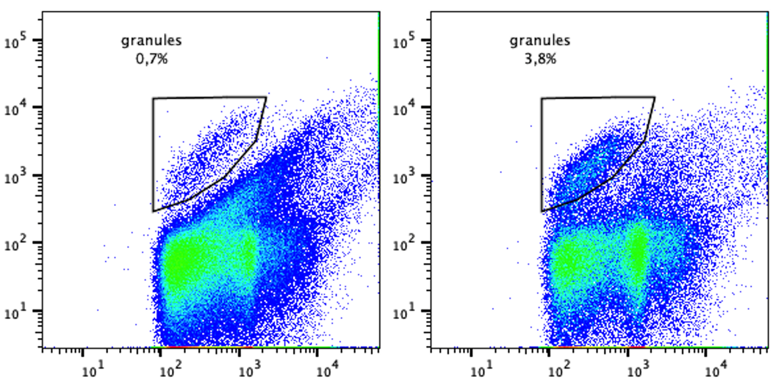
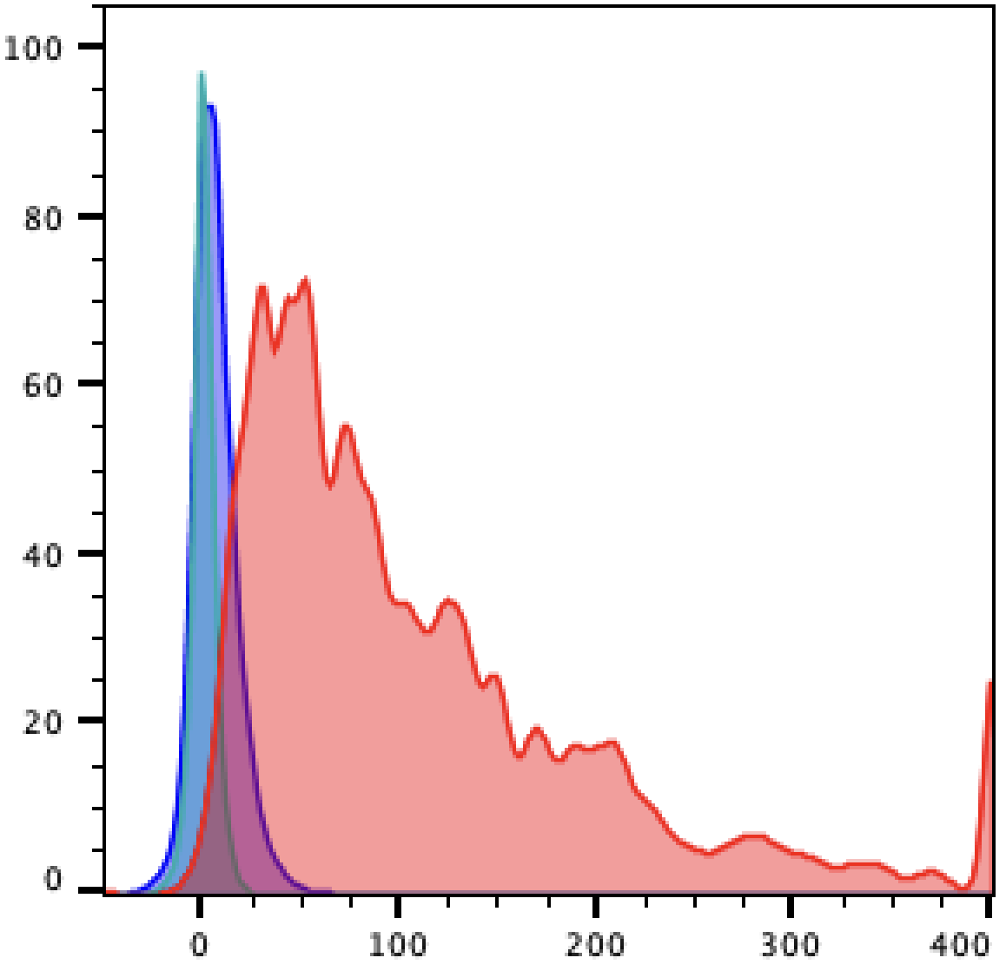
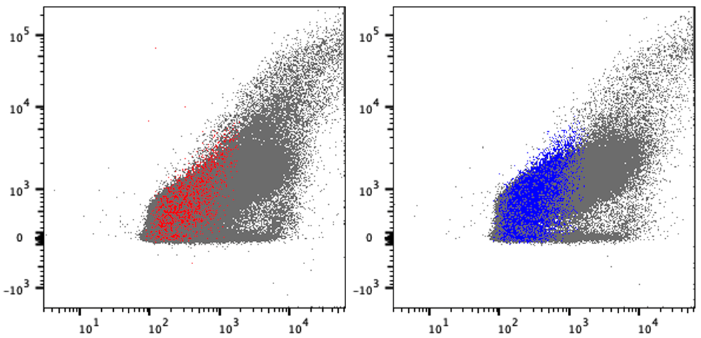
DHX9 is only expressed in UV- but not as- granules
4sU+UVA
arsenite
4sU+UVA
arsenite
G3BP1
WT-Hela
G3BP1
SSC
DHX9-eGFP
FSC
SSC
DHX9-eGFP
4sU+UVA
arsenite
Notes:
then I test it on both uv and arsenite stress.

Slide 14
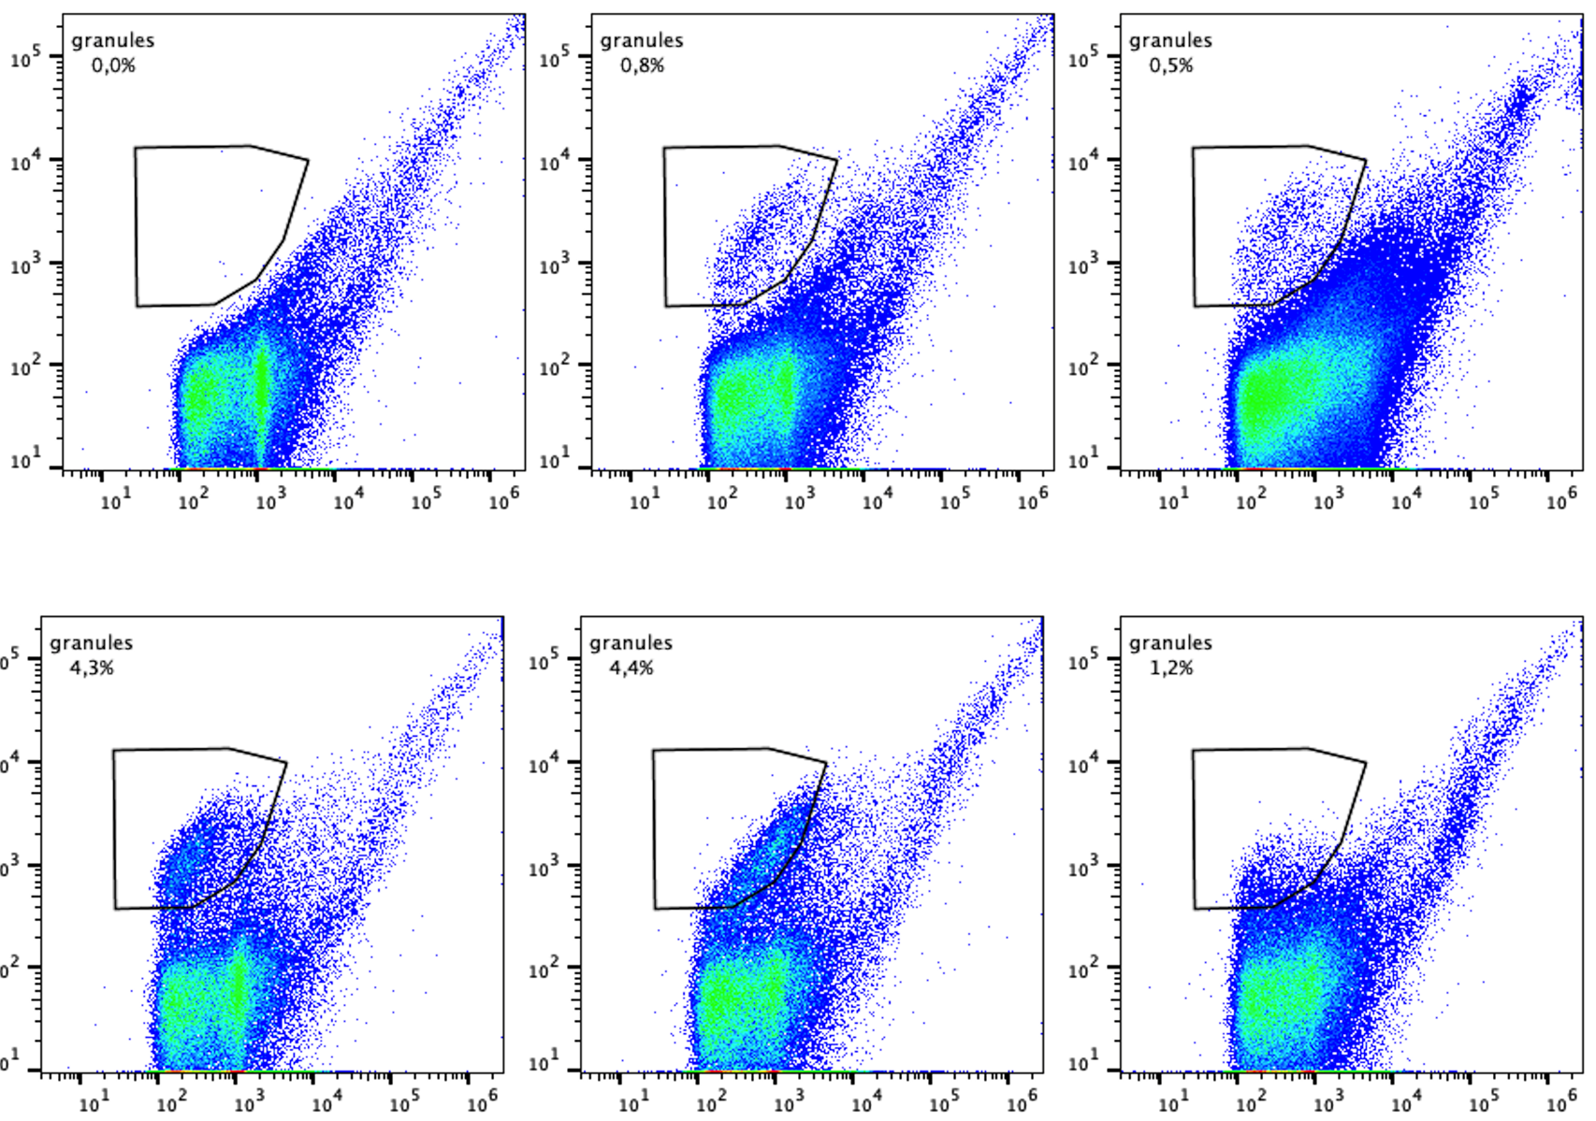
FANCI other stress granules
mock
UV
poly(I:C)
arsenite
Heat shock
osmosis
Notes:
since FANCI works well for asenite and uv, I then checked whether it will also work for other stress granules

Slide 15
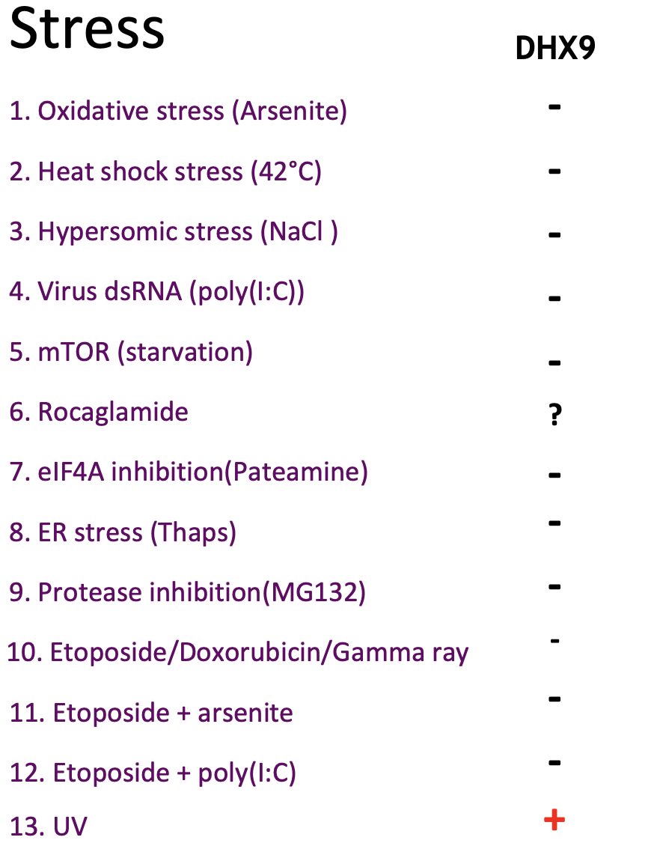
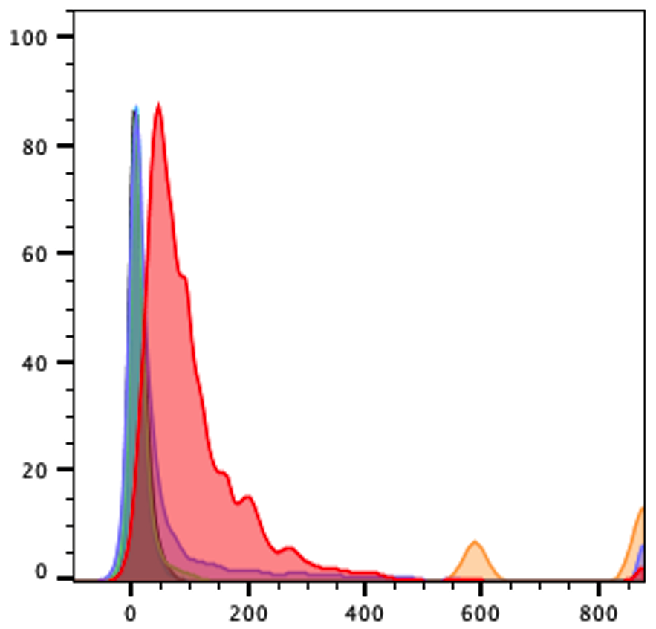
FANCI can be applied to all other stress induced granules
UV
poly(I:C)
Heat shock
Osmosis
Arsenite
mock
DHX9-eGFP

Slide 16
RNA-seq sample annotation_project 2201
sample name | note
1 | total RNA of mock-1
2 | total RNA of mock-2
3 | total RNA of mock-3
4 | total RNA of arsenite-1
5 | total RNA of arsenite-2
6 | total RNA of arsenite-3
7 | total RNA of UV-1
8 | total RNA of UV-2
9 | total RNA of UV-3
10 | SG RNA of arsenite-1
11 | SG RNA of arsenite-2
12 | SG RNA of arsenite-3
13 | SG RNA of UV-1
14 | SG RNA of UV-2
15 | SG RNA of UV-3
400000 stress granule particles are collected, generated 10ng RNA and sequenced
One 10 cm dish of cell is enough for UV SG
One well of Hela from a 6 well plate is enough for As SG
Wheeler et al.Methods.2018

Slide 17
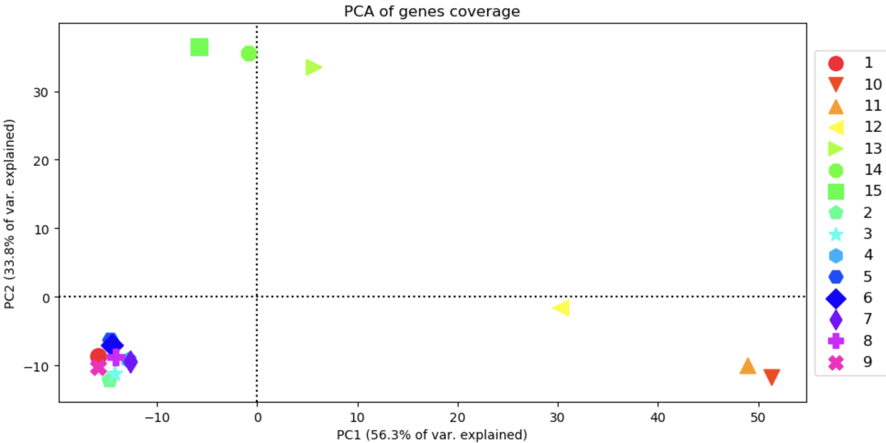
PCA analysis
As-sg-1
As-sg-2
As-sg-3
UV-sg-1
UV-sg-2
UV-sg-3

Slide 18
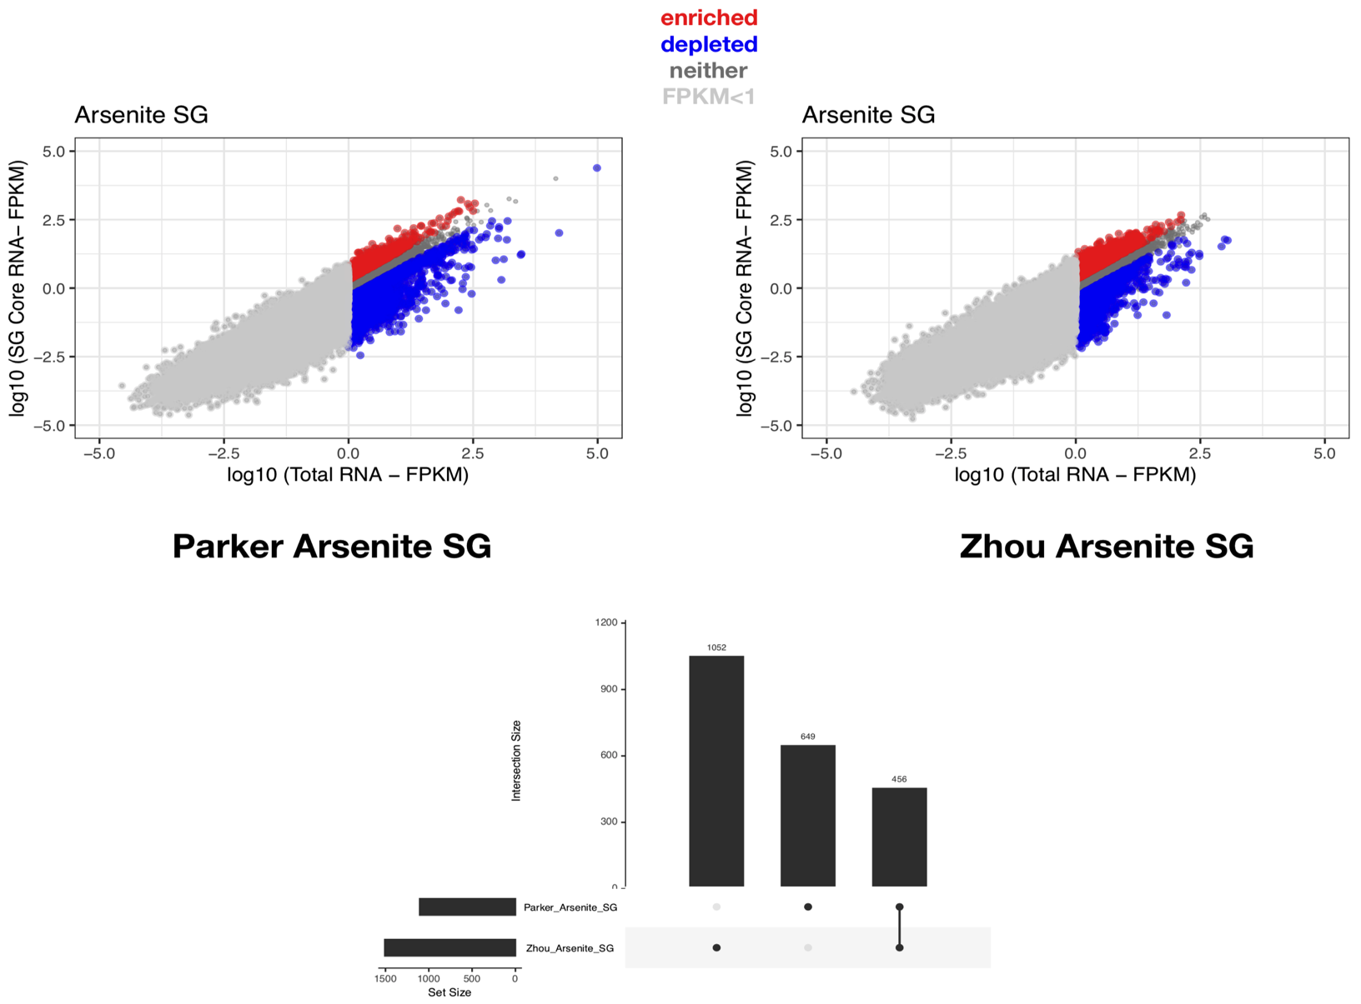
Comparison with Parker’s arsenite SG RNA profile
U2OS
As 60mins
Hela
As 30mins
1052 649 456
Analysis by Umut
Notes:
Parker AS vs Zhou AS

Slide 19
Genes of long introns with high transposon occupation is enriched in UV SG
124kb
mock
Input
As
4sU+UVA
As
FANCI-seq
4sU+UVA
mock
FLASH-seq
UVC
COA1

Slide 20
Genes of extreme long introns with high transposon occupation is enriched in UV SG
261kb
mock
Input
As
4sU+UVA
As
FANCI
4sU+UVA
mock
FLASH
UVC
NR6A1

Slide 21
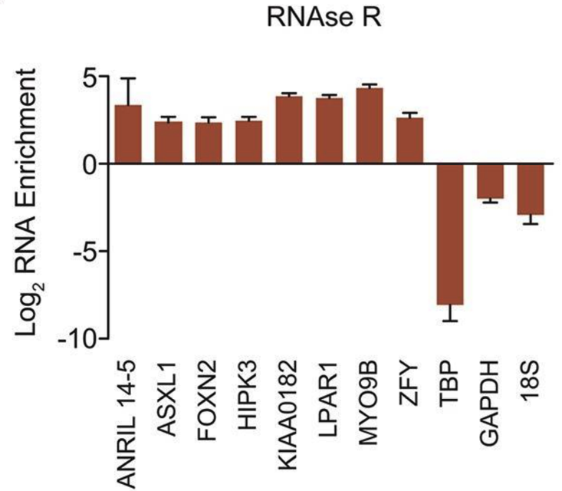
Circular RNA?
mock
Input
As
4sU+UVA
As
FANCI
4sU+UVA
mock
FLASH
UVC
ANRIL
Jeck et al.RNA.2013
FOXN2
ASXL1

Slide 22
Hypothesis
1, RNA damage disrupt splicing process, cause intron-retention or generation of circular RNA. These abnormal mRNA are sequestered into stress granules

Slide 23
1, A general RNA seq analysis of total RNA sample: (1,2,3) vs (4,5,6) vs(7,8,9)
Do we need a different tool as our RNA is total RNA but not polyA RNA?
Splicing might be very important for our project, what kind of splicing analysis we should do?
2, A RNA enrich analysis similar as the Mol cellular paper.
They take high expression genes and calculated the ratio of these genes in total and granule samples, then calculated whether there is an enrichment or not.
This might not work so good to us as for many genes, you can see mature mRNA in as granules(10,11,12) and immature mRNA in UV granules(13,14,15). They will be considered as genes in both granules but in fact their case is different.
3, maybe we can first calculate the ratio of extron/intron/UTR in each sample, and find that there are a lot of intron in UV granules but not as granules, then we check what these intron are, what genes they are and feature of these enriched introns.
4, we can overlap these introns or genes with published circular RNA dataset or m6A datasets, or calculate the tendency to form circular RNA
From literature: longer exons than average, surrounded by small introns having reversed Alu repeats, appear to be main features present in the RNA circularisation mechanism.
5, is it possible to distinguish mRNA and immature RNA from the reads? If yes, maybe we can check the correlation between mRNA abundance and intron-retention(or circular RNA) possiblity.
There seems to be a negative correlation between intron reads and 3UTR reads in granules.

